Slide 1

The Four C’s of diamond grading and their Effects on Price
Name: Mark McGuire
Date: 4/14/2018

Slide 2
Objective
Understand factors which may influence the price of a diamond.
Determine which of the four C’s influence the price of a diamond the most.

Slide 3
Background Data
When purchasing a diamond what are the most important characteristics to look for.
There are four C’s in diamond grading
Carat, Clarity, Cut , and Color
These are the four main characteristics that people look for when purchasing a diamond

Slide 4
Methods
Null Hypothesis: There is no statistical significance between a diamonds price and Carat, Cut, Clarity, and Color.
Alternate Hypothesis: There is no statistical significance between a diamonds price and Carat, Cut, Clarity, and Color.
Dataset:
Diamonds in the ggplot2 library
Linear Regression model with analysis of R-squared values
Process: Run lm on each ”C” and then combine variables to determine the “C” with the most influence.

Slide 5
Four C’s in the Diamonds dataset
Carat
range from (0.2 – 5.01)
Cut
Fair, Good, Very Good, Premium, Ideal
Clarity
(I1 (worst), SI2, SI1, VS2, VS1, VVS2, VVS1, IF (best))
Color
from J (worst) to D (best)

Slide 6
Results of the lm modeling
R-squared values:
Price ~ carat : 0.848
Price ~ cut: 0.012
Price ~ color: 0.032
Price ~ clarity: 0.026
Price ~ carat + cut: 0.855
Price ~ carat + color: 0.863
Price ~ carat + clarity: 0.894
Price ~ carat + clarity + color: 0.913
Price ~ carat + clarity + cut: 0.896
Price ~ carat + clarity + color +cut : 0.915
Notes:
% of the variation that is explained by the linear model.
R-squared is a statistical measure of how close the data are to the fitted regression line. It is also known as the coefficient of determination, or the coefficient of multiple determination for multiple regression.
The definition of R-squared is fairly straight-forward; it is the percentage of the response variable variation that is explained by a linear model. Or:

Slide 7
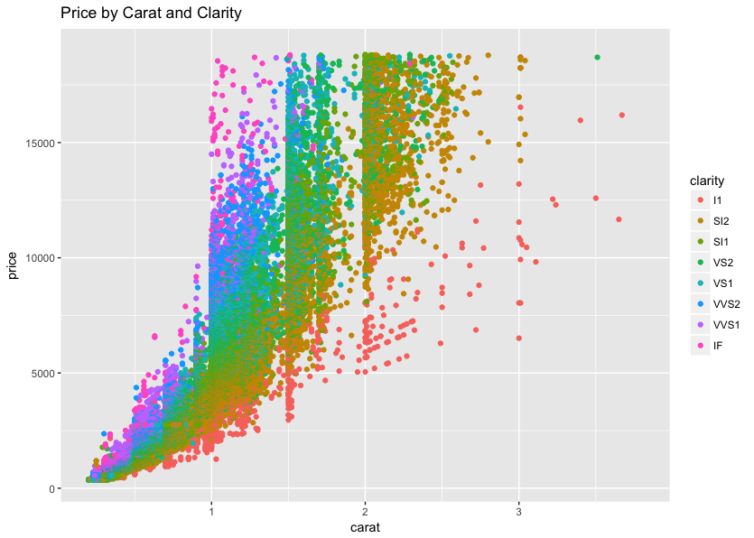

Slide 8
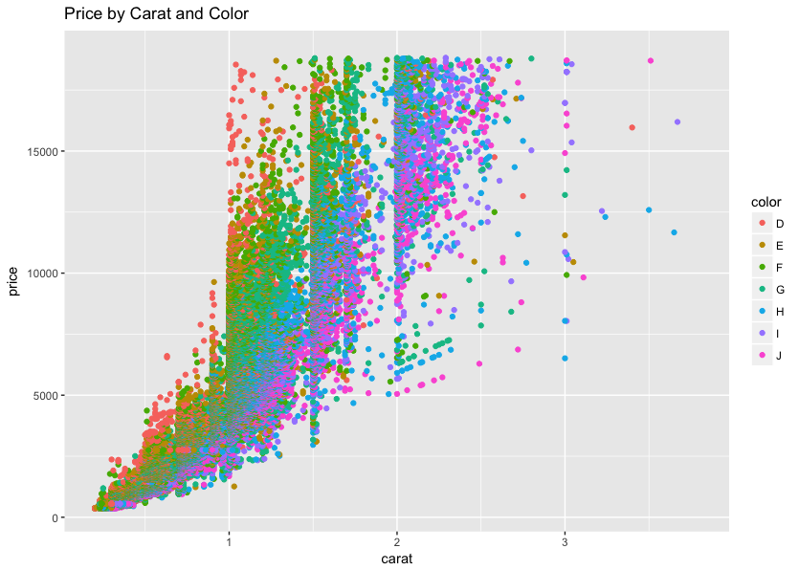

Slide 9
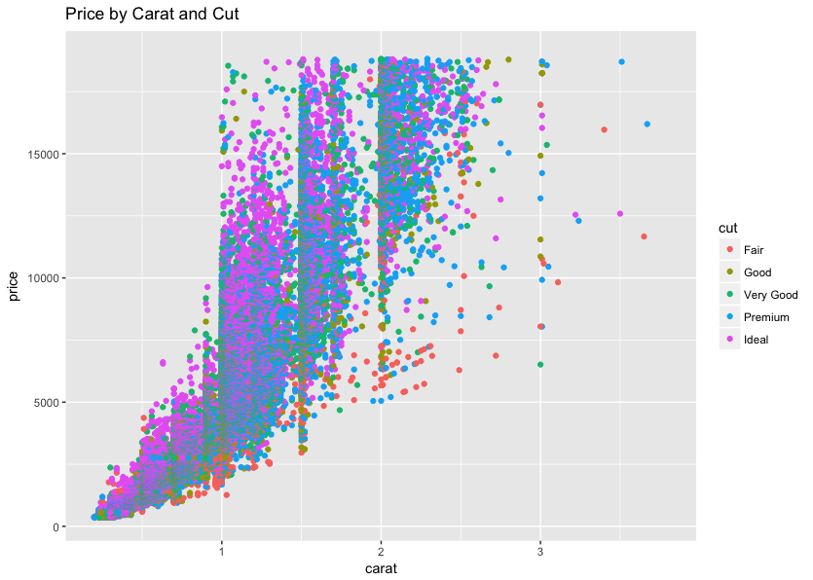

Slide 10
Conclusion
Carat is the most important ”C” when determining the price of a diamond
Clarity is slightly more significant that color but both are far less than carat
Cut is the least significant

